Slide 1
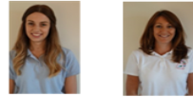
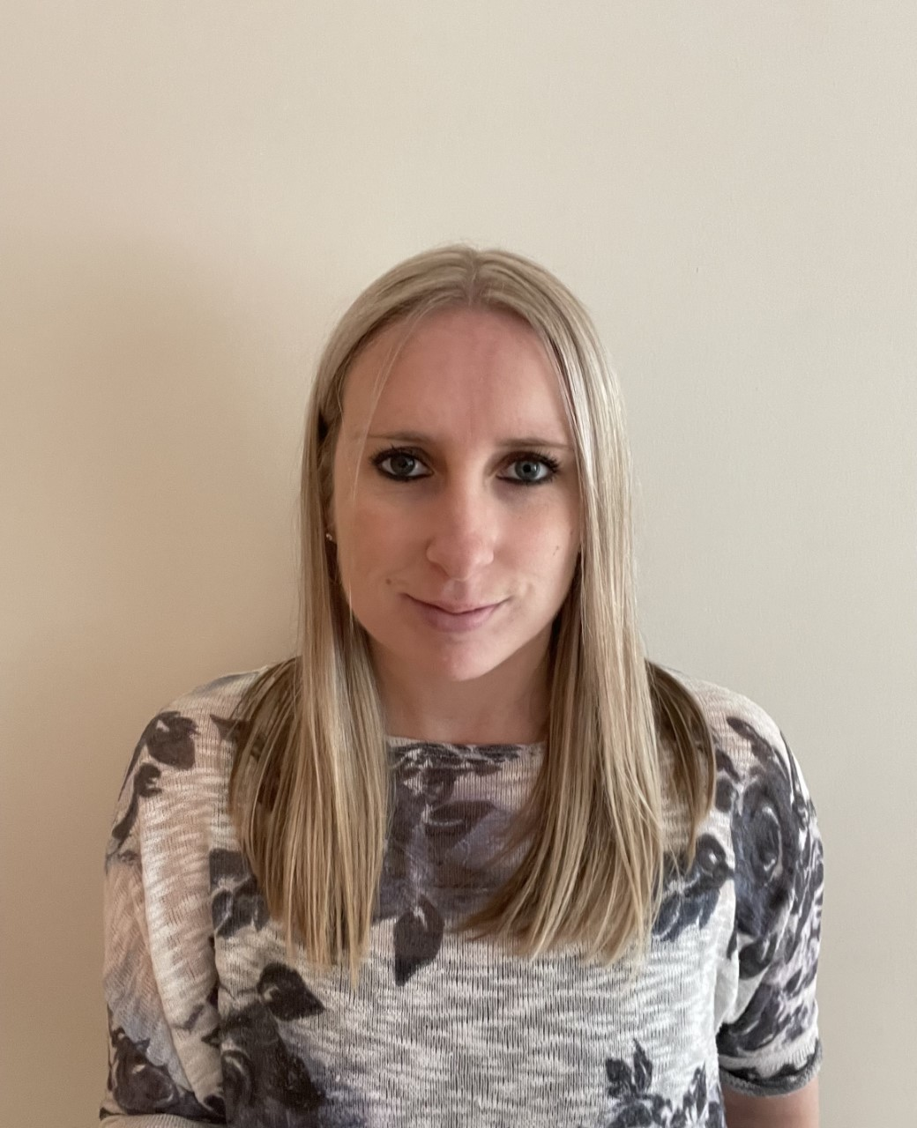
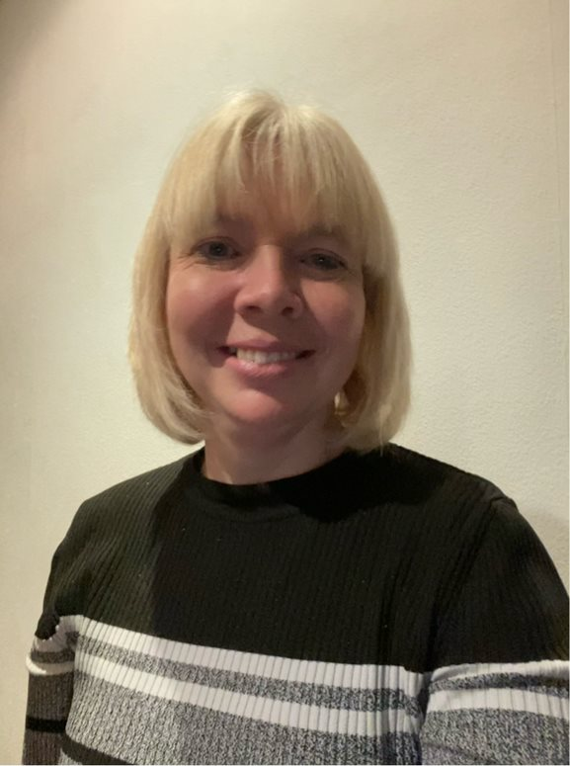
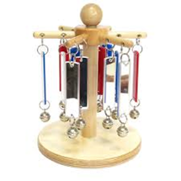
Welcome to Portage -The Team
What we expect from you
If your child is ill, or you are unable to keep the planned visit then please contact your Portage Home Visitor, as soon as possible, to cancel and rearrange another appointment
All resources left for your use between Portage visits must be returned to your Portage Home Visitor complete and in the same condition or you may be asked to contribute to its replacement
Please actively participate during Portage sessions with your child and continue to practice the activities modelled and discussed between visits i.e. minimise distractions (turn TV off)
Please keep your Portage Home Visitor up-to-date with any relevant information or appointments that your child may have
Hannah Dunn Linda Barker Sarah Bott Danielle Slater Allison Dundas
Nicola Denny Sian Baxter Val Little Wendy Robinson
What to expect from us
Your Portage Home Visitor will agree with you a mutually convenient time to visit
If for any reason your Portage Home Visitor is unable to make the planned visit, we will contact you to cancel and re-arrange
Your Portage Home Visitor will provide and leave you with the resources needed to carry out the teaching activities planned for
your child
Whenever possible your Portage Home Visitor will attend multi-agency meetings regarding your child

Slide 2
Northumberland Portage Service
Northumberland Inclusive Education Services
Low Incidence Needs Team (LINT), Portage Service
Riverside Centre, Armstrong Way
Ashington, Northumberland, NE63 0YD
Phone: 07966 774425/01670 622741
Admin: Sarah Bott
E-mail: Sarah.Bott01@northumberland.gov.uk
Portage Lead: Linda Barker
Email: Linda.Barker@northumberland.gov.uk
If you need this information in Large Print, Braille, Audio or in another format or language please contact us:
Telephone: 0345 600 6400
Typetalk: 018001 0845 600 6400
Northumberland Portage Service
Welcome to Portage

