Slide 1

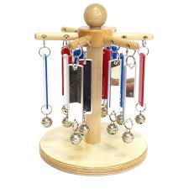


What is Portage?
How Portage Works
A Portage Home Visitor will visit the family home as agreed on a fortnightly/monthly/or weekly short-term basis. Together parents, carers and Home Visitors will plan activities to encourage and promote their child's learning and skills.
If there are other services already working with your child, then your Portage Home Visitor will:
Arrange joint home visits
Plan targets which can be combined with those of other professionals
Keep them up to date with what your child is doing and working towards
What Happens During a Home Visit?
Portage is a preschool teaching service for children with SEND. It enables parents and carers to support their child's learning.
The family and the Home Visitor agree a time for fortnightly/monthly visits or weekly short-term assessment
Following an initial assessment long term goals are agreed with parents/carers
Teaching activities based around play are planned and demonstrated by the Home Visitor and carried out between visits by parents/carers
Long Term goals are regularly reviewed and celebrated
The Northumberland Portage Team has a wide range of experience supporting children and their families.
The service is registered with the National Portage Association. Each Home Visitor is trained and qualified to carry out ‘Portage’ and deliver training to parents/carers and professionals.
The Portage Home Visitor shares information and supports the child's transition into a preschool setting / school
“Portage really gave me the confidence and the knowledge to draw out the very best from my child” [Quote from Parent]

Slide 2

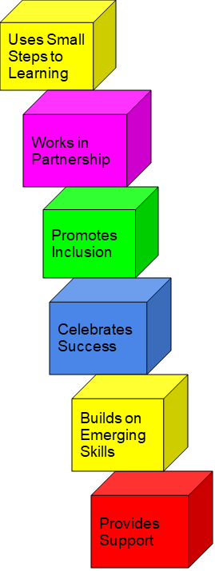


Portage ….
If you would like to make a referral to our service, please contact us at:
Northumberland Portage Service
Northumberland Inclusive Education Services
Low Incidence Needs Team (LINT), Portage Service
Riverside Centre, Armstrong Way
Ashington, Northumberland, NE63 0YD
Phone: 01670 622741/07966774425
Admin: Sarah Bott, Sarah.Bott01@northumberland.gov.uk
Northumberland Portage Service
A Preschool Teaching Service for Children with SEND
Information Leaflet for Parents
Portage Lead: Linda Barker Linda.Barker@northumberland.gov.uk or complete an online referral form at: www.northumberland.gov.uk
For more information regarding Portage visit:
www.portage.org.uk
If you need this information in Large Print, Braille, Audio or in another format or language please contact us:
Telephone: 0345 600 6400
Typetalk: 018001 0845 600 6400
Email:contactcentre@northumberland.gov.uk

